Slide 1

East Coast Floods
Review and Response
5 March 2024
Mech Simmer

Slide 2
Situation Trigger, Question
Situation
Trigger
Suncorp is currently facing a challenge with insufficient visibility into the impacts of major claims events. This lack of insight hinders our ability to efficiently handle such events.
This issue became especially evident during the recent influx of claims resulting from east coast floods. These events caused significant disruptions and led to poor claims efficiencies, affecting both our customers and our operational performance.
Question/Problem Statement
How can we leverage data visualizations to comprehensively analyze major claims events, gain valuable insights, and, in turn, enhance our claims efficiency?

Slide 3
Executive Summary of Recommendations
Answer
Our solution is to incorporate advanced data visualization techniques and tools into our claims management process. By doing so, we can create a visually informative dashboard and report that provide key insights, enabling us to monitor claims behavior in real-time and identify areas for improvement promptly. Through data analysis, we have identified priority areas that require attention to help facilitate informed decision making and claims management; better estimates prediction & tailored policies to accommodate claims costs

Slide 4
Enhance Claim Estimation Prediction
A review of the east coast flood data revealed a massive gap in our ability to accurately determine claims estimations. The total incurred costs were $4,477.396 compared to the input estimates of $1,045.301, meaning a difference of $3,432.095.
Supporting Chart 1 Revealed:
Majority of claims fall into the $5K-$10K Gross Incurred Cost (GIC) band
The higher the claims costs, the less accurate out estimates become
The higher the claims costs, the less number of claims
Claims with actual incurred cost over 100K were likely not considered a major loss sooner due to poor input of estimates.
Actions:
Estimation Models: Build estimation models based on historical claims data. This alleviates human error, and invokes data driven decisions.
Estimates Training: Implement training programs for claims staff to improve their ability conduct estimation, especially for higher values claims. This training will ensure that staff are providing accurate financial information, so Suncorp can accurately budget claims costs
Estimates Calculator: Introduce an estimates calculator tool for higher values claims. This tool will allow claims staff to input specific case details and receive more accurate estimates based on historical data and patterns.
Periodic Estimation Reviews: To maintain accuracy, conduct periodic reviews of claim estimations and adjust them as needed. These reviews will ensure that our estimates are as close to actual costs as possible, promoting reliability.

Slide 5
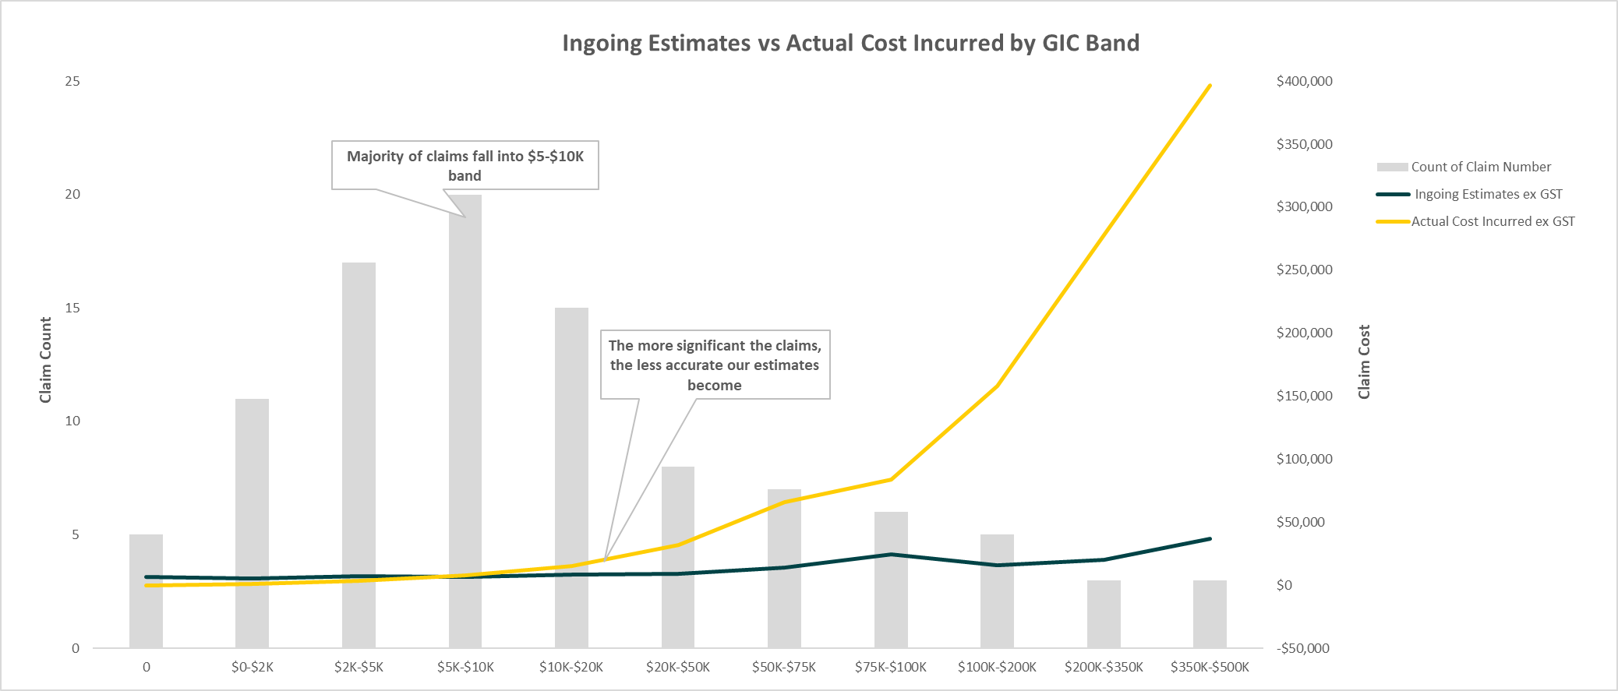
Supporting Chart 1

Slide 6
Tailor Policies to Accommodate Claims Cost
The east coast flood data showed rain was the main contributor to lodged claim. Of these claim customers home building, and building and contents was impacted. With further data analysis Suncorp can tailor policies to customer needs in high risk areas, this will in turn better budget for future claims cost.
Supporting Chart 2 & 3 Revealed:
On average rain was the primary loss cause for customers, but had minimal financial impact
Claim costs was significantly higher for flood damage, even though less customers were impacted
Overall more claims were lodge for homes
Of those homes building, and building + contents customers were the most impacted
Customers with contents only policies, lodged significantly less claims, with less costs incurred
Actions:
More Data: Obtain additional event data from the past 3 years to confirm if flood is incurring higher costs compared to rain damage. This will solidify an existing pattern and drive further changes. Review data for impacted postcodes, so customers with home building, and building and contents policies can be prepared for claims events. This can also drive policy suggestions to protect customers, and reduce future claims costs for Suncorp.
Tailored Natural Hazard Policies: Based on data, consider offering opt in, or opt out specific insurance policies or endorsements for customers in high-risk areas to help them manage claims costs.

Slide 7
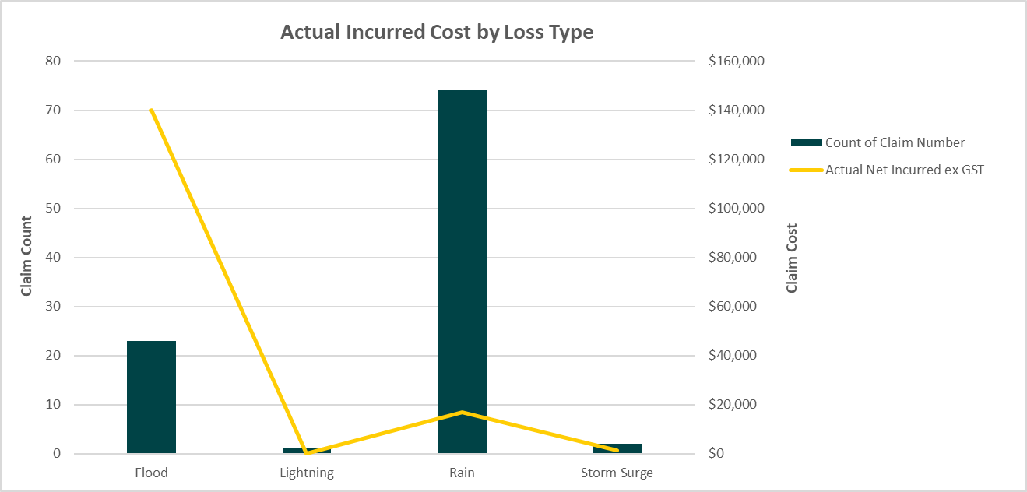
Supporting Chart 2

Slide 8
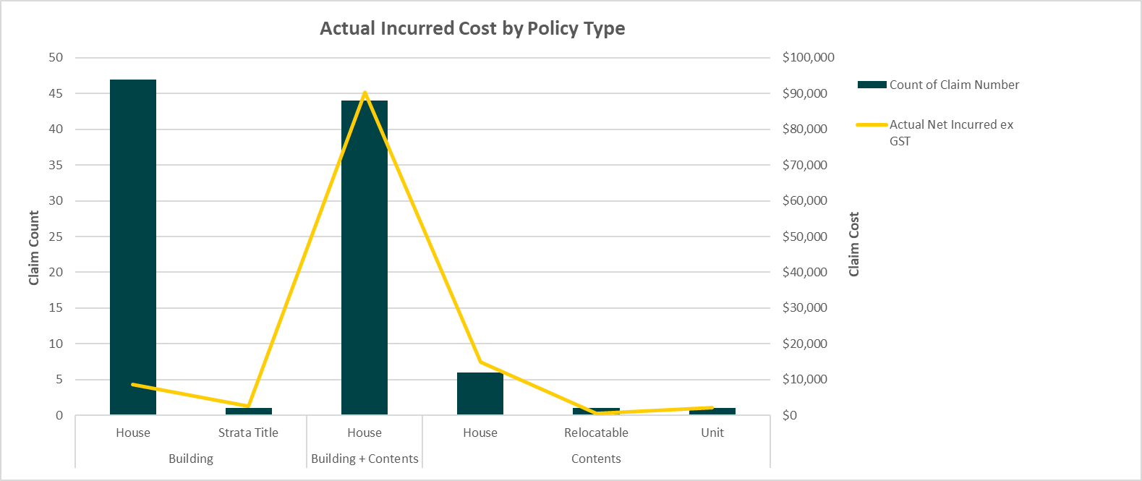
Supporting Chart 3

Slide 9
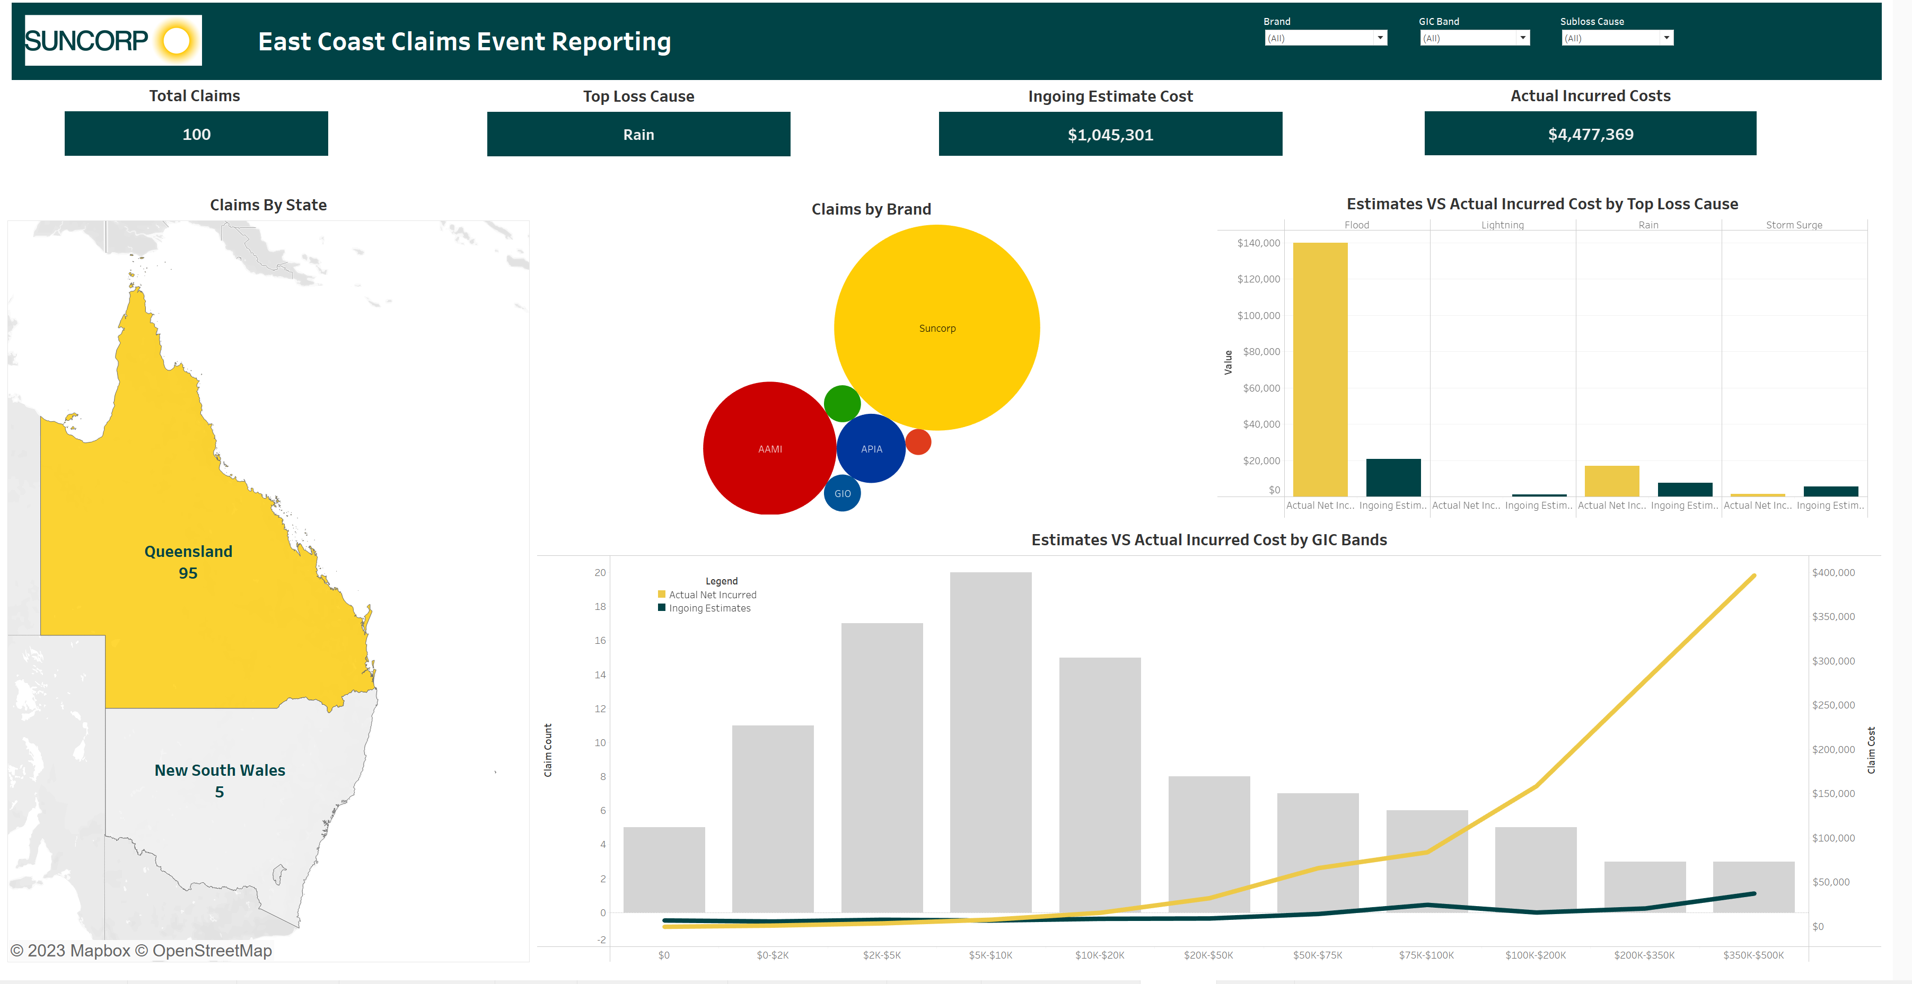

Slide 10
Dashboard Rationale
The East Coast Reporting dashboard adopts a dual operational and strategic approach. Its primary objective centers on highlighting the pivotal effects of the claims event through the presentation of high-level metrics and prominent callouts. The dashboard encourages user exploration through interactive features while also pinpointing potential areas for improvement. It leverages a visual language that incorporates branded colors to accentuate key details, sizing to emphasize distinctions, and legends for context and clarity. Furthermore, it ensures consistency by integrating the branded logo. Additionally, it employs principles of visual perception to streamline comprehension, reducing cognitive load and enhancing clarity.
Choice of Charts
The bubble chart was used to draw attention to the distribution of claims. You can clearly & easily identify by the size of the bubble the brand where majority of claims were lodged. The matching of colour to brand further enhanced readability & visual appeal.
The use of the map best represented number of claims by state as this was geographical data. Using elements of visual perception, such as highlighting Queensland in yellow, and NSW as grey, creating visual hierarchy thus identifying the key point.
The use of a combo chart (bar and line), and Suncorp brand colour template allows users to understand the key message & easily reveal trends between multiple variables.
Interactivity
With the use of interactive elements such as tooltips, hovering, filters, and clickable components allows the audience to explore complex the dataset on their own terms.
The use of data brushing also helps business managers explore correlations between different charts, as one data point is selected the connected data point in another chart updates dynamically.

Slide 11
Dashboard Rationale
Insights
The actual incurred costs significantly exceeded the initial estimates provided
Majority of claims were located in Queensland
Further data for postcodes are required to pinpoint exact locations to serve these high risk areas better
Majority of claims were Suncorp & AAMI
Flood estimates proved to be a more challenging task for the claims staff
Majority of claims are costing between $5K-$10K
A review of claim characteristics that fall into this band can be reviewed to help identify future claims and there corresponding bands
The more significant the claims costs the less accurate estimates became
There potentially needs to be an uplift in high value estimates training
Negative values were evident in both estimates and incurred costs
This could be linked to human error, or a processes issue within the claims department
Further data analysis will need to be completed to confirm if the issue is systemic

